Slide 1
Solutions and Concentration
Lucarelli Chapter 16

Slide 2
Objectives
Define the terms: solution, solute, solvent, electrolyte, saturated.
Analyse a solubility curve.
Calculate the concentration of a solute dissolved in solution.
Write balanced chemical equations with observations (ppt reactions).
Write balanced net ionic equations with observations.

Slide 3
Solutions
Solution: a homogenous mixture of a solute dissolved in a solvent.
Solubility of a solute: a mass that can dissolve in 100 g of water.
Generally solubility increases with temperature
Gases are always less soluble at higher temperature!

Slide 4
Solutions
Saturated: a solute can no longer dissolve in a solvent.
Unsaturated: more solute can be dissolved in a solvent
Supersaturated: more solute dissolved in a solvent than is expected at a certain temperature.

Slide 5
Electrolytes
Electrolytes: solutes that produce ions when dissolved in a solvent (e.g. NaCl)
Strong: entire solute is ionised
Weak: party ionised, some compound present in molecular form
Non-electrolyte: do not produce ions
All ionic compounds are strong electrolytes.
Most covalent are non-electrolytes.
Covalent acids can be weak electrolytes (Year 12 – equilibrium)

Slide 6
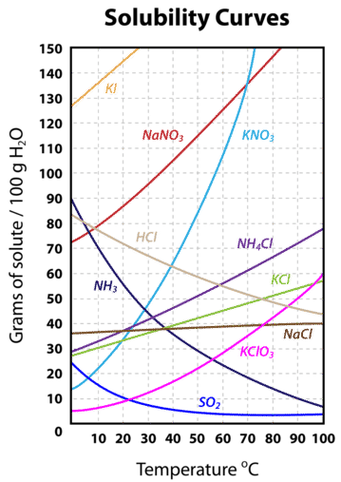
Solubility Curves
Solubility decreases with temperature = gas
You can determine the solubility (saturated) in 100 g water at any temperature between 0 and 100 C.

Slide 7
Concentration
Concentration is the amount of solute dissolved in a volume of solvent.
Concentration units that you must know!
mol L⁻¹
g L⁻¹
mg L⁻¹ (ppm)
C = n / V

Slide 8
Concentration
g / L = g L⁻¹
mol L⁻¹ x g mol⁻¹ = g L⁻¹
g L⁻¹ x 1000 mg g⁻¹ = mg L⁻¹ (ppm)

Slide 9
Question
1.75 g of sodium carbonate is dissolved in 100 mL of water. What is the concentration of sodium carbonate in mol L⁻¹, g L⁻¹ and ppm?
0.25 mol of potassium phosphate is dissolved in a 250 mL water at 50 C. What is the concentration of potassium phosphate in mol L⁻¹, g L⁻¹ and ppm?

Slide 10
Question
1.73 g of silver phosphate was precipitated from a reaction of silver nitrate (40.0 mL)
and potassium phosphate (40.0 mL). Write the balanced chemical equation and determine the concentration (in molL⁻¹, gL⁻¹, and ppm) of silver nitrate in its 40.0 mL solution before mixing.

Slide 11
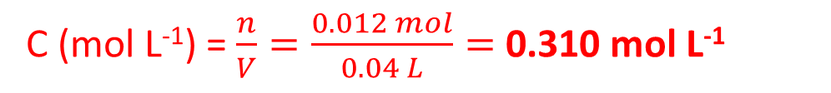
3 AgNO₃ + K₃PO₄ → 3 KNO₃ + Ag₃PO₄
n = 0.012 mol
C (mol L⁻¹) = $\frac{n}{V}=\frac{0.012 mol}{0.04 L}=$ 0.310 mol L⁻¹
C (g L⁻¹) = 0.310 mol L⁻¹ x 169.87 g mol⁻¹ = 52.62 g L⁻¹
C (mg L⁻¹) = 52.66 g L⁻¹ x 1000 mg g⁻¹ = 52617 mg L⁻¹
m (AgNO₃) = 0.012 mol x 169.87 g mol⁻¹ = 2.104 g
C (g mol⁻¹) = $\frac{m}{V}=\frac{2.104 g}{0.04 L}=$ 52.62 g L⁻¹
C (g mol⁻¹) = $\frac{m}{V}=\frac{2.104 g}{0.04 L}=$ 52617 mg L⁻¹

Slide 12
Concentration of ions
1.25 g of (NH₄)₃PO₄ was dissolved in 80 mL of water. What is the concentration of ammonium ion in the solution in molL⁻¹ ?

Slide 13
Concentration of ions
1.25 g of (NH₄)₃PO₄ was dissolved in 80 mL of water. What is the concentration of ammonium ion in the solution in mol L⁻¹ ?
n [(NH₄)₃PO₄] = m / M = 1.25 g / 149.08 g mol⁻¹ = 8.38 x 10⁻³ mol
C [(NH₄)₃PO₄] = n / V = 8.38 x 10⁻³ mol / 0.08 L = 0.105 mol L⁻¹
C (NH₄⁺) = 3 x 0.105 mol L⁻¹ = 0.314 mol L⁻¹

